Slide 1
Views of S-3D-JDF-exit_section_assembly.dgn
S-3D-JDF-exit_section_assembly.dgn
pw://PWINT-WPC.EIS.DS.USACE.ARMY.MIL:CENWP&space;-&space;Portland&space;District/Documents/D{e1a0d319-85fc-421f-a165-c8ef757e594b}

Slide 2
Concept
Minimize long-term O&M requirements and increase system reliability by installing a gravity water supply system for the LPS.
DESIGN FACTORS
Gravity water supply (from North Fish Ladder) must meet LPS flow requirements:
150 gpm design flow; 124 gpm down flume; 15 gpm for the collection tank; ~11 gpm to provide adjustability
Screening for water supply must meet NOAA fry criteria:
‘Active debris cleaning’ velocity maximum 0.4 ft/s
‘Passive debris cleaning’ velocity maximum 0.2 ft/s
Note: An active system within the fishway is likely not acceptable
Location and shape of water supply intake and screen must minimize potential salmonid and lamprey interaction/entrainment risks and risks associated with debris.
Notes:
Our intent is to provide a gravity-fed system instead of pumps. The existing pumps are prone to failure and increase the Project’s O&M costs. We’d rather leave John Day with a robust system that requires little maintenance.

Slide 3
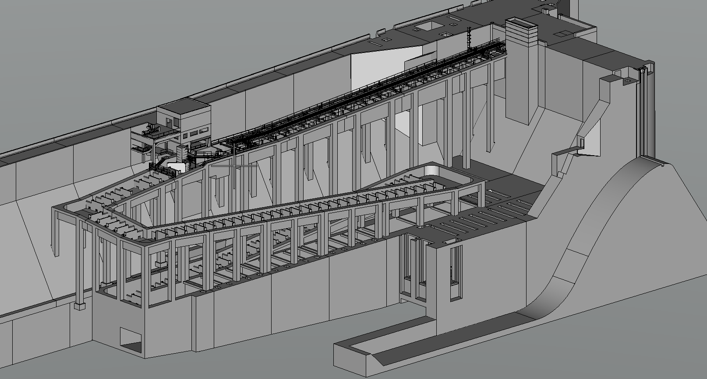


Proposed source – install a picket lead in the corner of the turning basin and provide juvenile screening.
Approximate location of the new collection tank.
Alternate source – pull water from the count station behind picketed leads. This location has concerns with higher construction cost and more challenging maintenance.
Notes:
Isometric view of our proposed and alternate sources for gravity-fed water. The proposed source would be cheaper and easier to construct than the upper source at the count station.

Slide 4
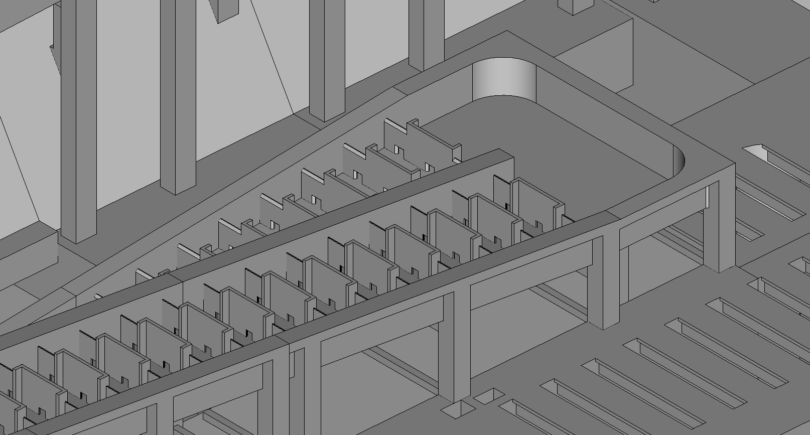
Isometric view of proposed new picket lead in the lower turning basin.
Proposed collection tank location.
Notes:
Isometric view of the proposed new picketed lead.

Slide 5
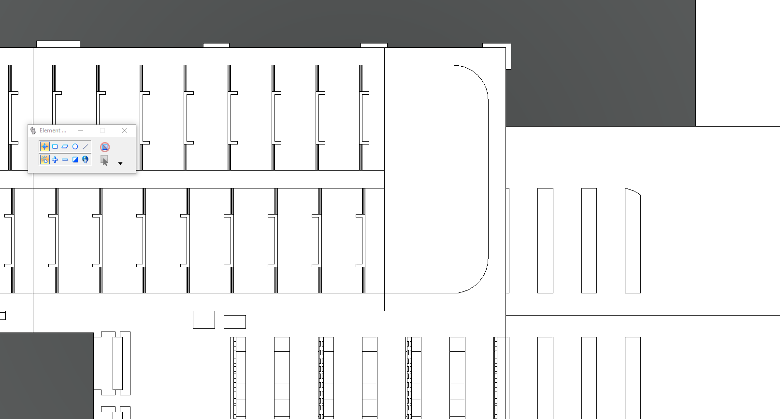
14.5’
9.5’
12’
3” pipe & valve
Fish Screen
Picket Lead
24’
52’

Slide 6
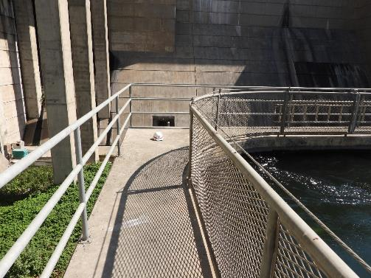
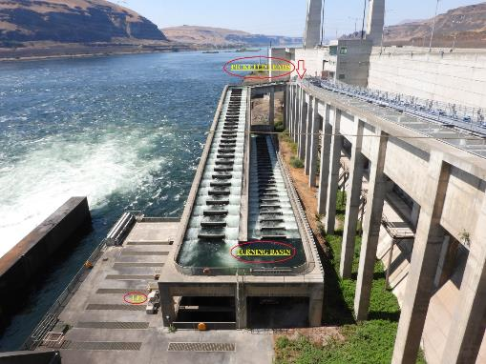
photos
Corner of lower turning basin:
View from on top of the dam:
Notes:
Photos showing the corner where we’re proposing to install a new picketed lead, and an overall view of both potential water sources in relation to the collection box location.

Slide 7
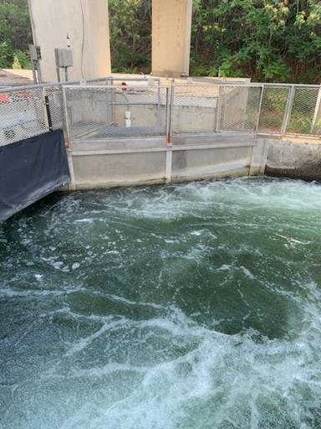
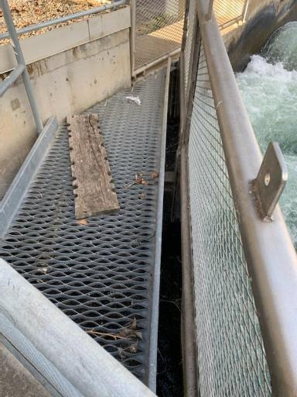
photos
South ladder count station:
South ladder picketed lead:
Notes:
Example of a screened area in the JDA south fish ladder. The water level sensor for the AWS butterfly valves is located in a stilling well behind this area. We’re proposing a similar screening system for our preferred water source in the north ladder.

Slide 8
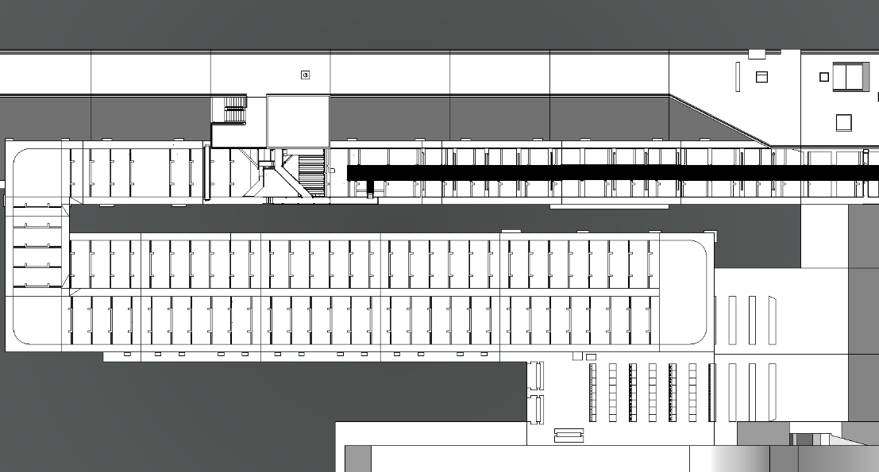


Existing picket lead near count station
Proposed new picket lead in turning basin
Notes:
Top view of the scope showing the direction of water flow and fish movement.

Slide 9
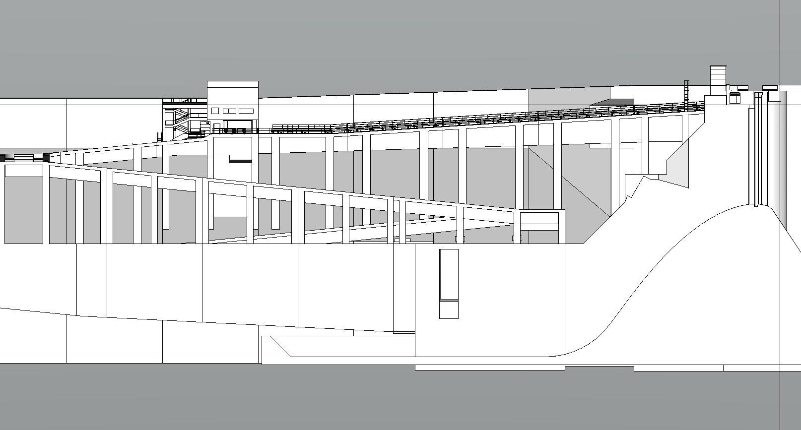
Construction of the count station source would require cranes from the deck above, and a longer pipe run down to the collection tank.
Construction of the lower source could be accomplished with Project staff and equipment that’s already on-site.
Notes:
Noting the difference in construction complexity between the two potential water sources. The cranes needed to build the upper source would have to be contracted, versus using the crane we already have and Project staff for the lower source.

